Slide 1
Comparing Boroughs in Toronto, Ontario, Canada to Boroughs in New York City, New York, USA
Capstone Project - The Battle of the Neighborhoods (Week 2)

Slide 2
Business Problem
In this project we will try to find which neighborhoods in New York City, New York most closely resemble which neighborhoods in Toronto, Ontario, Canada.
Specifically, this report will be targeted to stakeholders interested in moving from Toronto, Ontario, Canada to New York City, New York.
There are numerous factors that make up a neighborhood, but in this study to focus on comparing the number of restaurants and proximity to major airports in Toronto and New York.

Slide 3
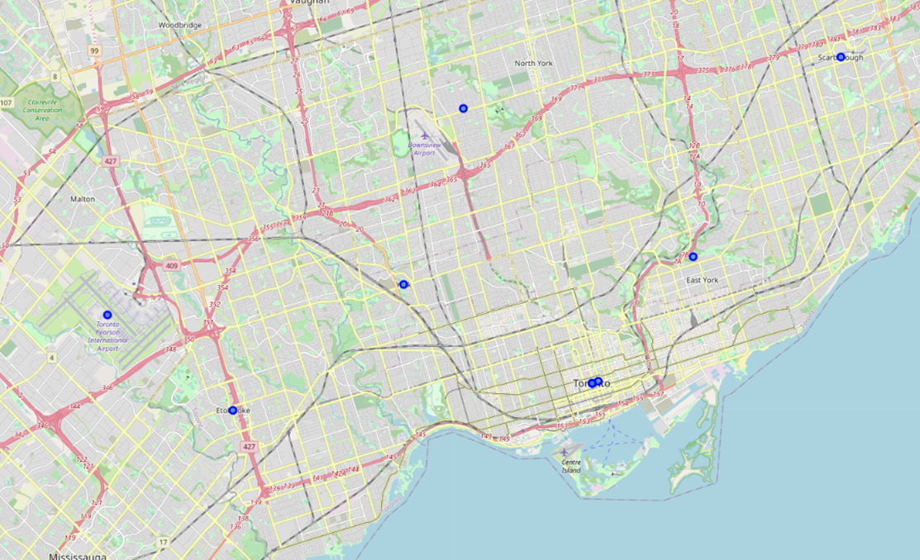
Toronto Boroughs

Slide 4
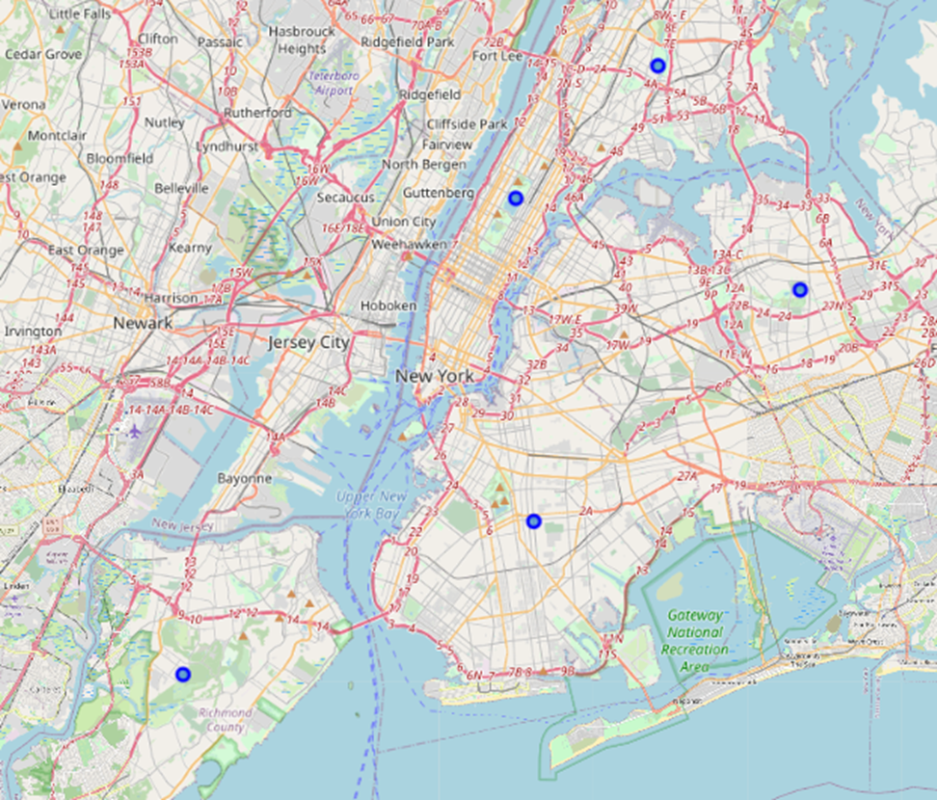
New York Boroughs

Slide 5
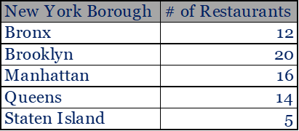
Restaurant Counts
Brooklyn has the highest number of restaurants in New York with 20; Mississauga and Central Toronto in Toronto also have 20.
Staten Island has the fewest in New York, where Etobicoke has the fewest in Toronto.

Slide 6
Air port Proximity
New York Borough | Dist. To Airport
Bronx | 9.4 miles
Brooklyn | 12.6 miles
Manhattan | 7.9 miles
Queens | 6.3 miles
Staten Island | 25.9 miles
Staten Island is the furthest from the air port (Laguardia) in New York at 25.9 miles; East York is the furthest in Toronto (Toronto Pearson) at 22.4 miles.
The Bronx is the closest to the air port in New York at just 6.3 miles; West Toronto is the closest in Toronto at 8.4 miles.
Toronto Boroughs | Dist. To Airport
East York | 22.4 miles
Scarborough | 21.1 miles
East Toronto | 17.6 miles
Downtown Toronto | 16.4 miles
Central Toronto | 16.2 miles
North York | 12.7 miles
York | 11.8 miles
Mississauga | 9.7 miles
Etobicoke | 9.3 miles
West Toronto | 8.4 miles

Slide 7
Conclusion
Borough Comparison Based on Restaurants
New York Borough | Corresponding Toronto Borough
Bronx | Downtown Toronto, Scarborough, West Toronto
Brooklyn | Central Toronto, Mississauga
Manhattan | East Toronto
Queens | North York
Staten Island | East York, Etobicoke, York
The boxes here show which boroughs in Toronto most close resemble the boroughs in New York based on number of restaurants and proximity to the air port.
Borough Comparison Based on Air Port Proximity
New York Borough | Corresponding Toronto Borough
Staten Island | East York, Scarborough
Brooklyn | East Toronto, Downtown Toronto, Central Toronto, North York
Bronx | Mississauga, Etobicoke
Manhattan | West Toronto
Queens | West Toronto

